Slide 1
IMDB Movies Dataset
(1000 Movies )

Slide 2
Problem Statement:
Mr. X is an aspiring producer. He wants to produce a new movie but wants to do some research with the movies released in past 10 years.
He reaches out to Y, an analytics firm to provide some insights on the same.
The data science Team of Y uses the Dataset of 1000 movies to carry out the required analysis.
Mr.X wants to produce a movie which we provide higher revenue, good Rating and Metacritic score.
He also wants a genre filtration for a successful movie.

Slide 3
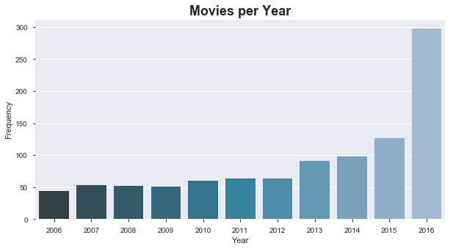
Count of Movies Released in last 10 Years:
The above Graph shows the trend of Count of Movies Released every Year. Since 2015 there has been a significant increase in number of Movies.

Slide 4
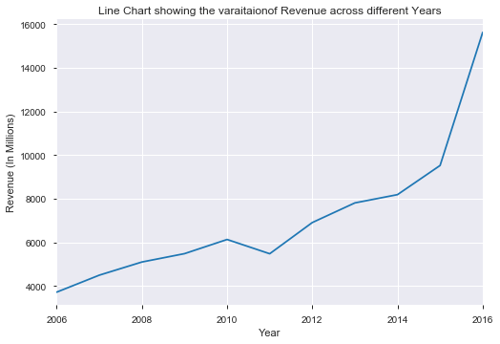
Has there been an increase in Revenue earned?
The above line Graph shows the Amount of Revenue earned since 2006 in Millions. The trend is increasing year by year except once in 2011.

Slide 5
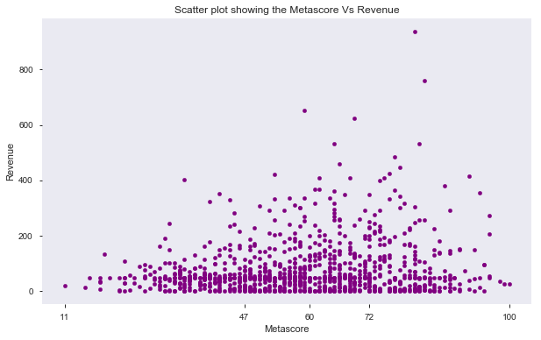
Metascore Vs Revenue
The above scatter plot distribution does not follow any trend.

Slide 6
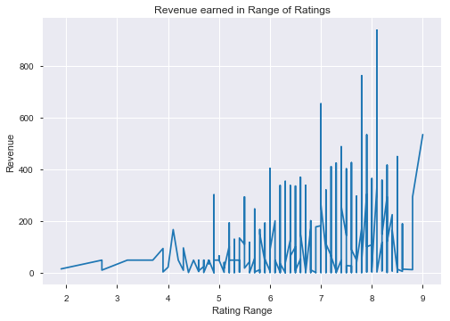
Revenue distribution in different Ratings:
Movies with a Rating from 7 to 8 provide a higher revenue for most of them. There are other factors affecting Revenue too.

Slide 7
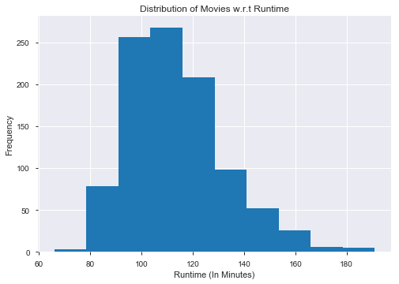
Movies distribution with respect to Runtime:
The above Histogram shows the distribution of Movies with respect to Runtime. Most of the Movies are in Range of 100 to 120 minutes.

Slide 8
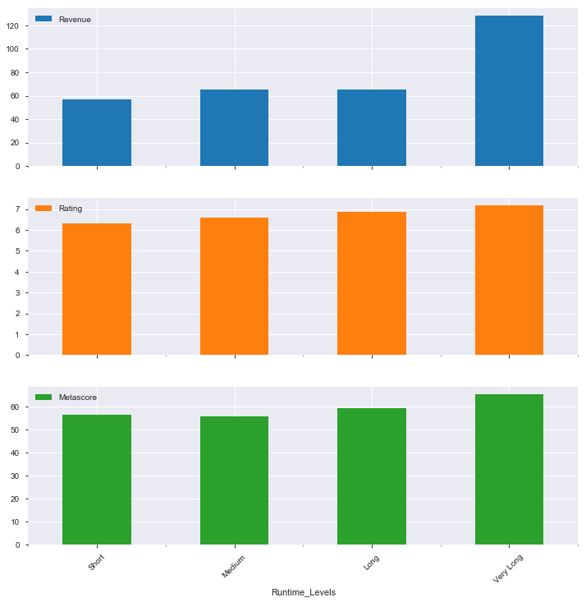
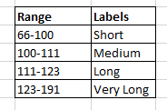
Runtime Levels w.r.t Revenue,Metascore and Rating:
Longer the Runtime more is the Revenue, Rating and Metascore.

Slide 9
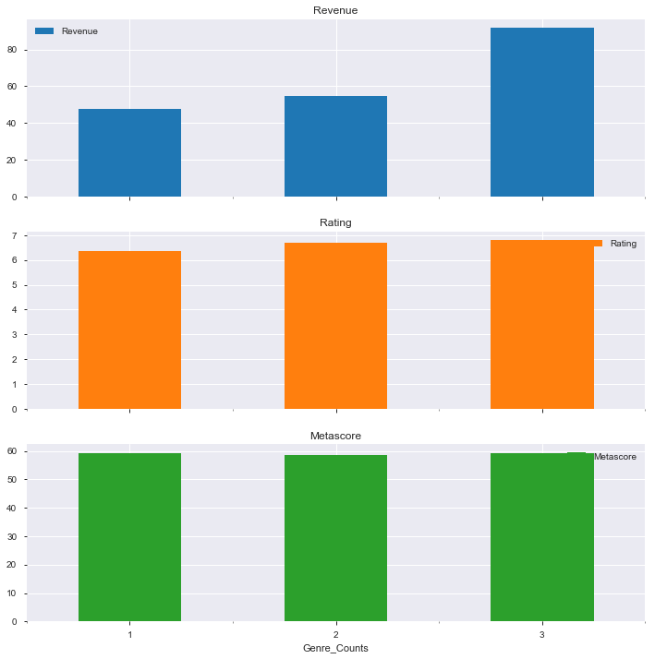
Genre Count for Revenue,Metascore and Rating:
The 3 bar graphs are plotted between Genre count on X axis and Revenue, Metascore and Rating on Y axis. A significant change can be observed in Revenue hike.

Slide 10
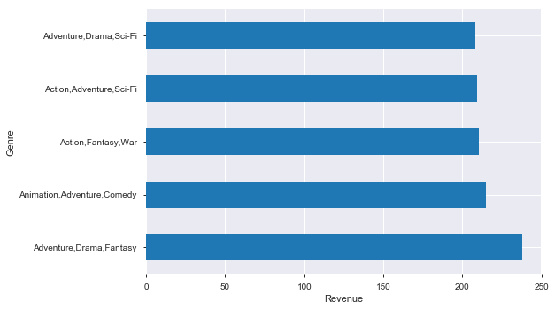
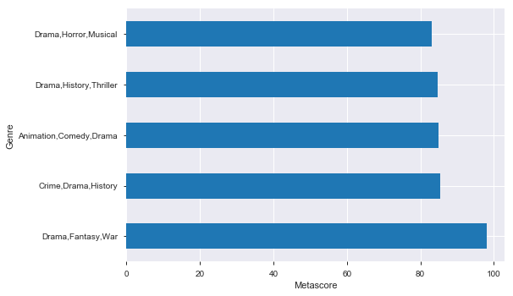
Top Genre Combination:
Adventure, Drama and Fantasy Contribute for more Revenue.
Drama, Fantasy and War contribute for higher Metascore.

Slide 11
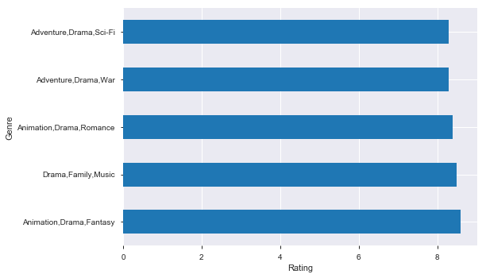
Top Genre Combination:
Animation, Drama and Fantasy are loved by viewers.

Slide 12
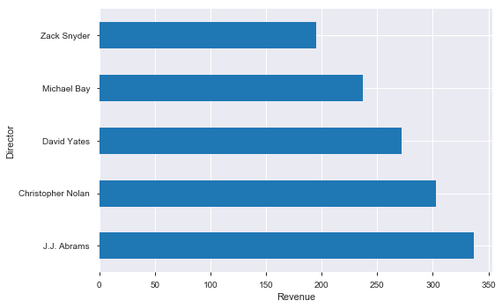
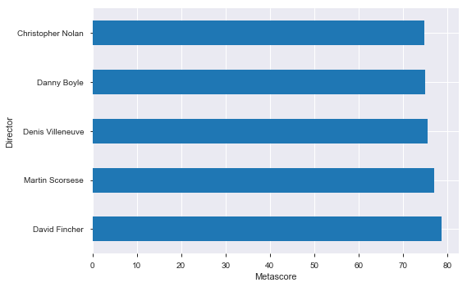
Top Directors:
J.J Abrams’s Movies earn higher Revenue.
David Fincher’s Movies are preferred more by critics.

Slide 13
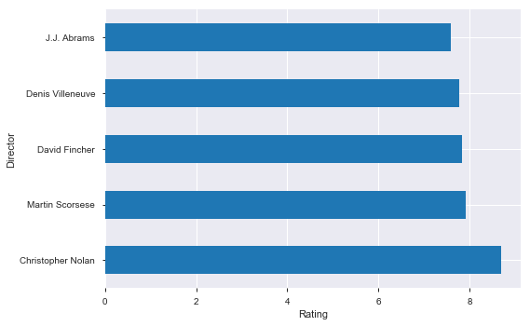
Top Director:
Christopher Nolan’s movies are most popular among all.

Slide 14
Conclusions:
The numbers of Mvoies released every year is increasing.
With the number of Movies released increasing , the Revenue earned is also at a higher end.
An Average rating around 7-8 generates higher Revenue.
Revenue and Critics Score are not dependant on each other.
Mvies having Runtime greater than 123 minutes results into higher Revenue, Popularity as well as Positive reviews from critics.
Movies having Genre count of 3 are more profitable. In which Drama and Fantasy are common in all.
J.J Abram, David Fincher and Christopher Nolan's Movies are are top in Revenue.Metascore and Rating Respectively.

Slide 15
Business Insights:
Following features can be applied by Mr.X to Movies for gaining maximum profits and popularity:
Runtime of Movies should be more than 123 minutes.
Genre count should be 3 or more including Drama and Fantasy as an addition.
J.J Abram, David Fincher and Christopher Nolan should be preferred as Directors .
All the above features can be inculcated in Movies so that movies becomes a Hit.

